Slide 1


Reflusso Duodeno
Gastro Esofageo e
Prevenzione
Prof PAOLA IOVINO
Gastroenterologia
Università di Salerno

Slide 2
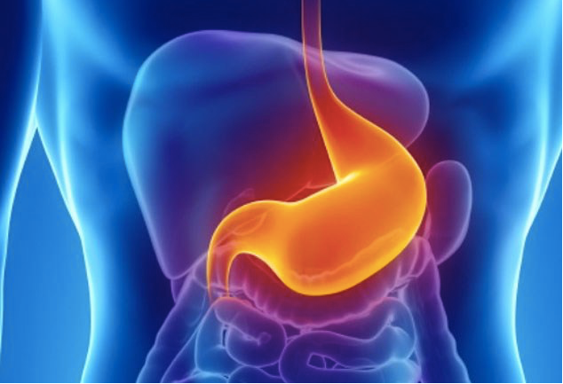
What is BILE reflux?
When the material produced by the pancreas and the liver gets into the duodenum, it is mixed with duodenal fluid and form a solution that contains also bile
Basnayake C APT 2021

Slide 3
What is GERD?
When this solution gets into the stomach and then up into the esophagus,
It is called bile reflux.
Basnayake C APT 2021

Slide 4
What is BILE reflux?
Bile reflux is ALSO named
DUODENO-GASTRO-ESOPHAGEAL REFLUX
Basnayake C APT 2021

Slide 5
Normally, there is always a certain amount of duodeno-pancreatic secretion that goes into the stomach, most commonly at night and postprandially. In the stomach, this solution is mixed with gastric content, which is, most of the time, acid.
Keaneetal. 1981; Sonnenbergetal. 1982; Thompson 1982; Heading 1983; Muller-Lissner 1983),

Slide 6
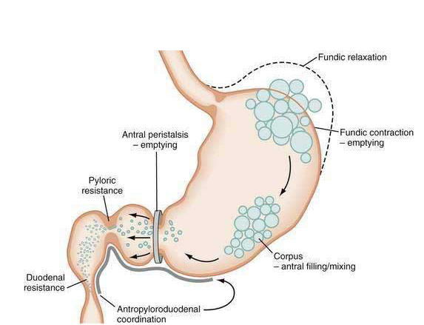
/grinding
Notes:
/grinding

Slide 7
What is GERD?
Reflux of gastric contents to the esophagus is a physiological event: a healthy person typically has reflux episodes.

Slide 8
What is GERD?
GERD is a condition which develops when the reflux of stomach contents causes troublesome symptoms and/or complications
Vakil N et al. Am J Gastroenterol, 2006

Slide 9
‘troublesome symptoms’ =
MODERATE-SEVERE symptoms that occur more than once a week
Vakil N et al. Am J Gastroenterol, 2006

Slide 10



Vakil,2006
La MRGE è una condizione che si sviluppa quando un reflusso di contenuto gastrico causa sintomi o complicanze fastidiosi
Sindrome esofagea
Sindrome extraesofagea
Sindrome
sintomatica
Sindrome con
danno esofageo
Associazione
stabilita
Associazione
ipotizzata
Sindrome tipica da reflusso
Sindrome da reflusso con dolore toracico
Esofagite
Stenosi
Es. Barrett
AdenoCa esofageo
Faringite
Sinusite idiopatica
Fibrosi polmonare idiopatica
Otite media ricorrente
Tosse da reflusso
Laringite da reflusso
Asma da reflusso
Erosione dentale da reflusso

Slide 11
How is bile reflux distinguished from acidic reflux?
It is not possible to distinguish BILE REFLUX from ACIDIC REFLUX in terms of signs and symptoms.

Slide 12
Other than acidic reflux, are there any conditions with which bile reflux can be confused?
Bile reflux ≠ nonacidic reflux
Nonacidic reflux is a type of refluxate that can be recognized only by pH-impedance monitoring.
Nonacidic reflux might or might not contain bile.
Bile is more often associated with acidic gastric juice than with a nonacidic component of gastric contents.
Basnayake C APT 2021

Slide 13
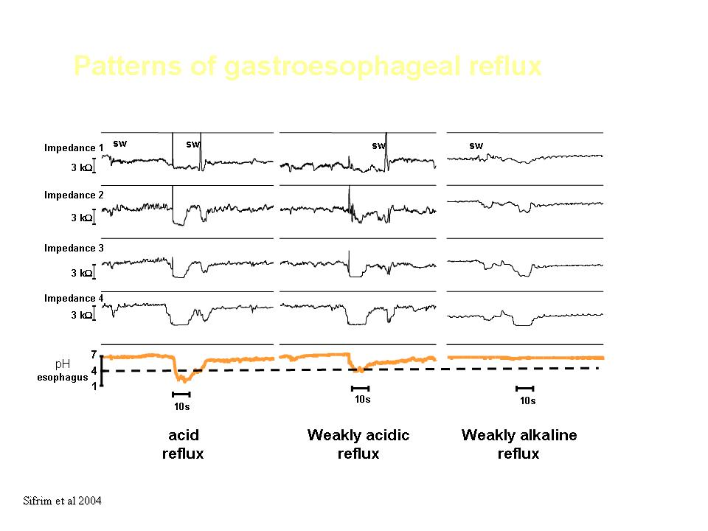
Patterns of esophageal reflux

Slide 14
Other than acidic reflux, are there any conditions with which bile reflux can be confused?
Bile reflux ≠ nonacidic reflux
Nonacidic reflux is a type of refluxate that can be recognized only by pH-impedance monitoring.
Nonacidic reflux might or might not contain bile.
Bile is more often associated with acidic gastric juice than with a nonacidic component of gastric contents.
Basnayake C APT 2021
Notes:
.

Slide 15
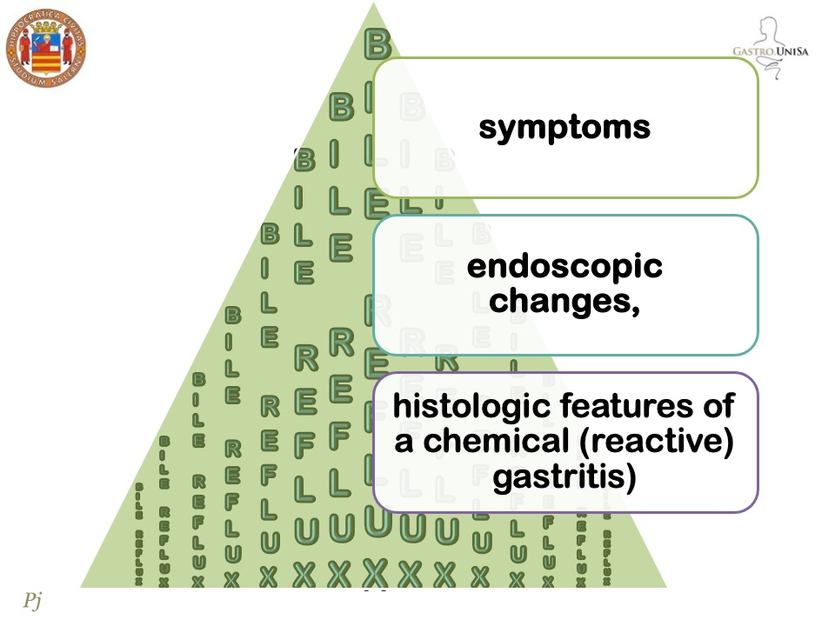

Slide 16
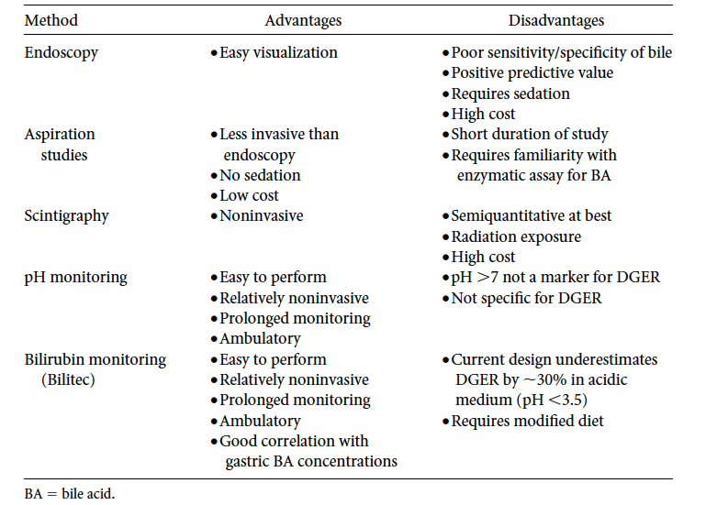
Vaezi and Richter Am J Med. 2001

Slide 17
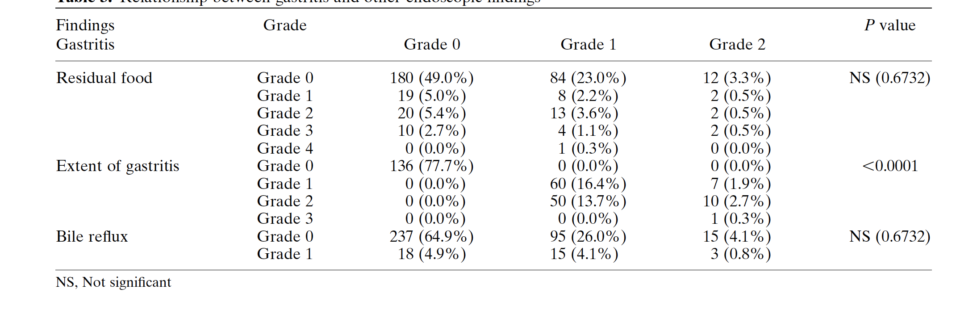
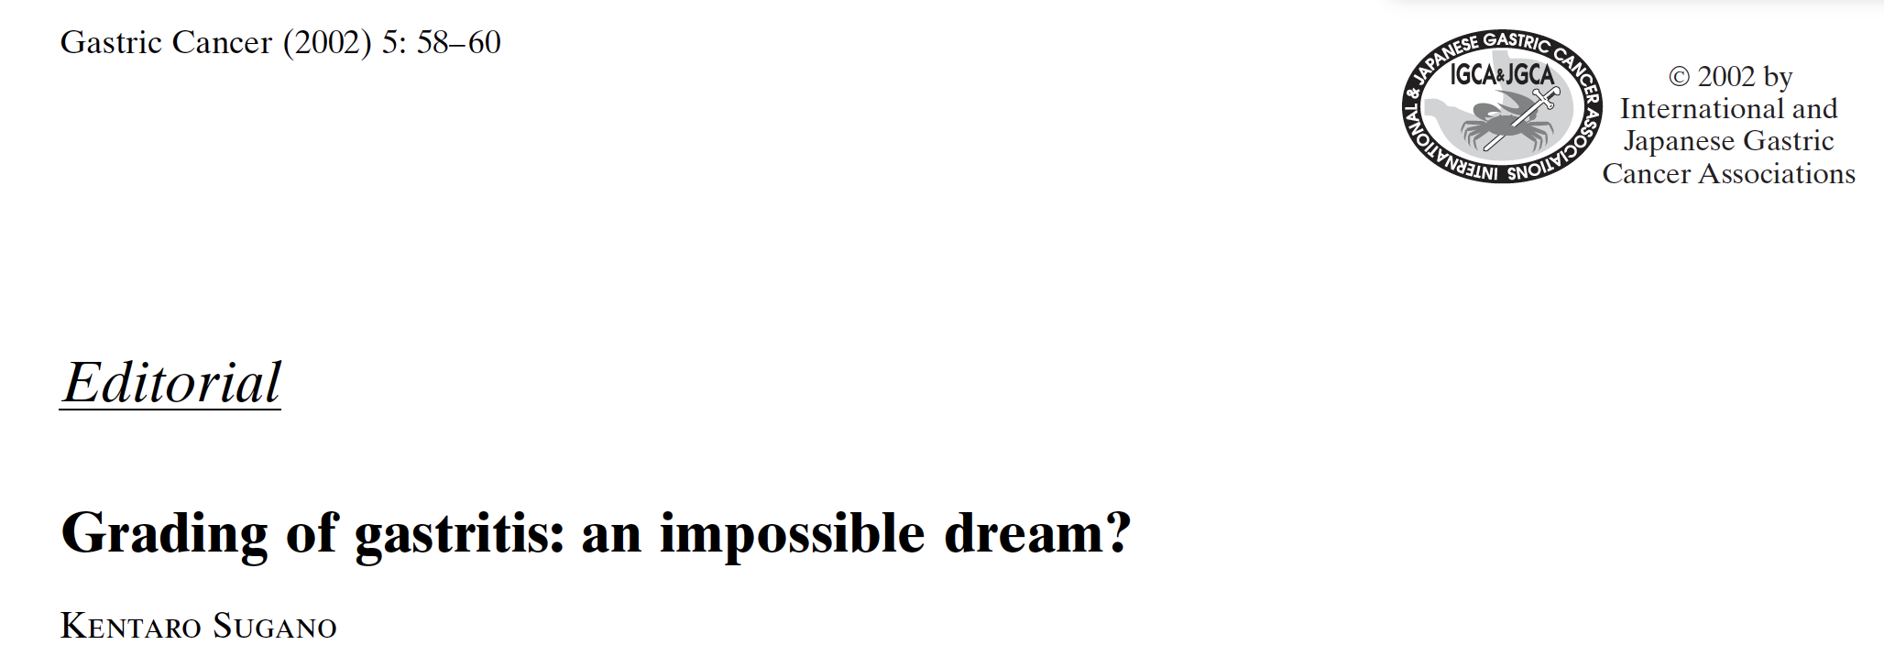
Kubo M et al Gastric Cancer (2002) 5: 83–89
In consideration of all of these difficulties in evaluating
the functional state of the residual stomach by endoscopy
alone, it seems that any attempt to determine the
grade of gastritis with visual indices alone is an impossible
dream.

Slide 18
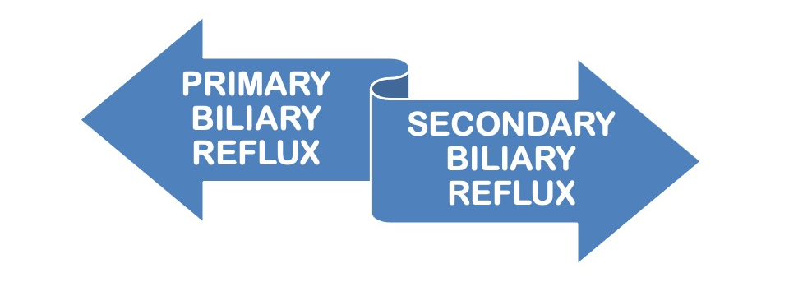

Slide 19
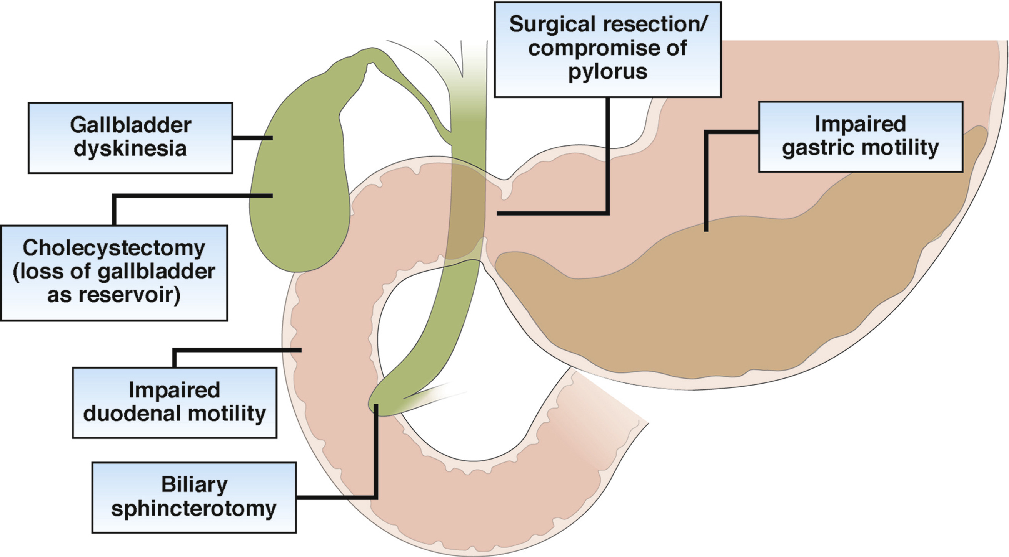

Slide 20
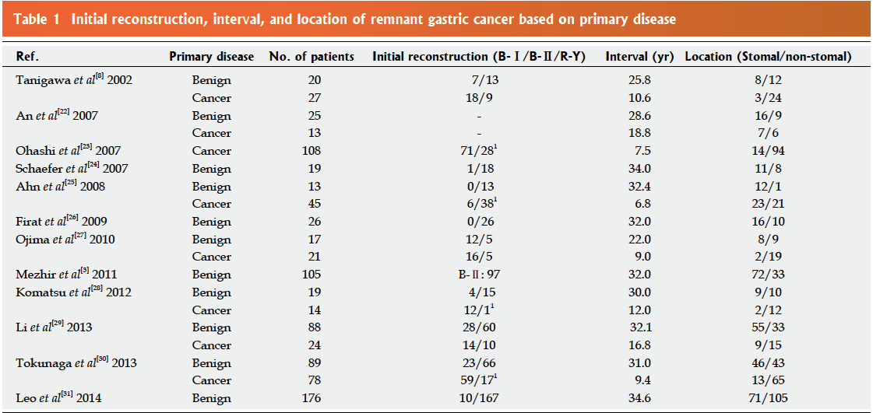
Ohira M World J Gastroenterol 2016

Slide 21
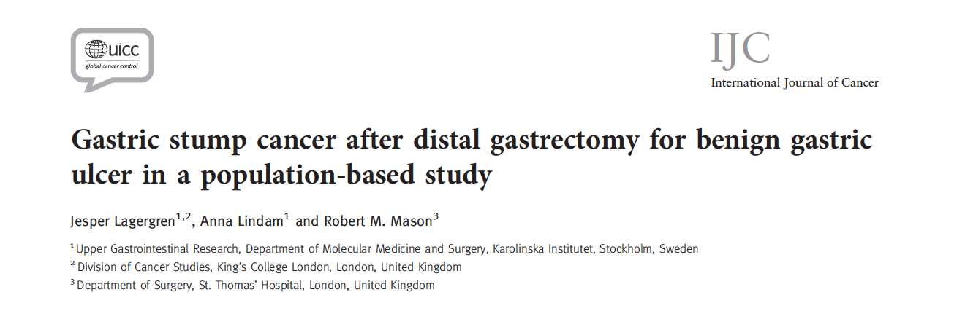
In conclusion, this large population based study revealed
a prevalence 140/ 18912 (0.74%) of remnant gastric cancer
an increased risk of cancer in the gastric remnant only 30 years or longer after gastric resection for benign disease, whereas other factors did not influence this risk.
2012

Slide 22

the main factors responsible for changes affecting remnant gastric mucosa after distal gastrectomy
Chronic damage attributed to duodenogastric reflux
is
one of
Miwa K et al Carcinogenesis 1992;
Kondo K et al Carcinogenesis 1995;
Kondo K et al Gastric Cancer 2002;

Slide 23
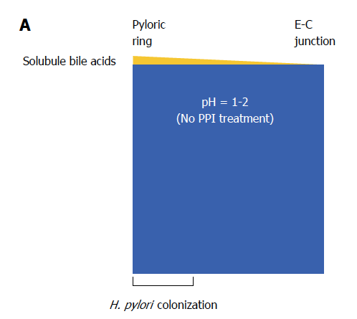
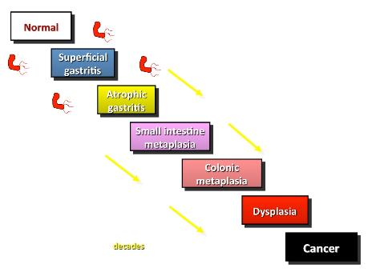
Mukaisho et WJG 2014
bile acids are chemorepellents for H. pylori
Worku ML et al J Med Microbiol 2004
an inverse relationship exists between bile reflux and the presence of H. pylori, which may account for the absence of H. pylori in the stomach with persistent biliary reflux
Thao TD et al Biochem Pharmacol 2008

Slide 24
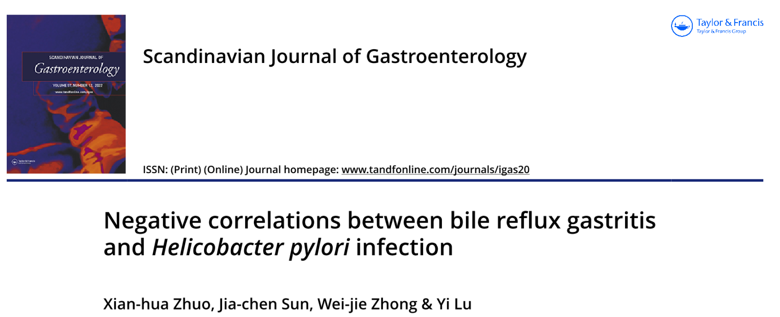

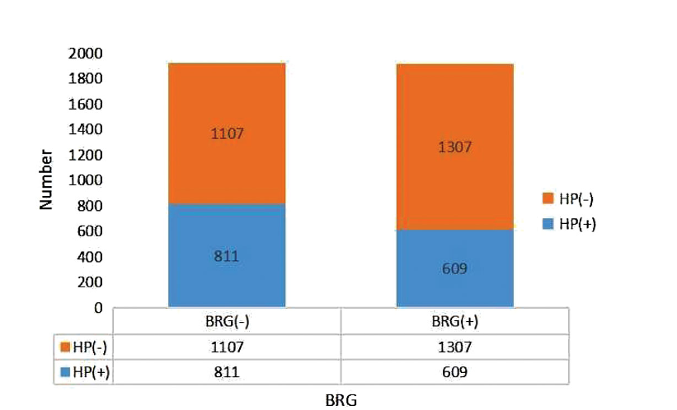

Slide 25
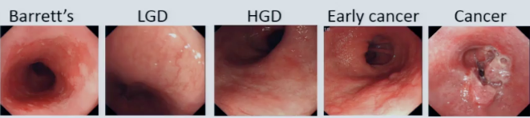
Which is the impact of bile acids and bile salts on the esophageal mucosa and the development of Barrett’s esophagus and cancer ?

Slide 26
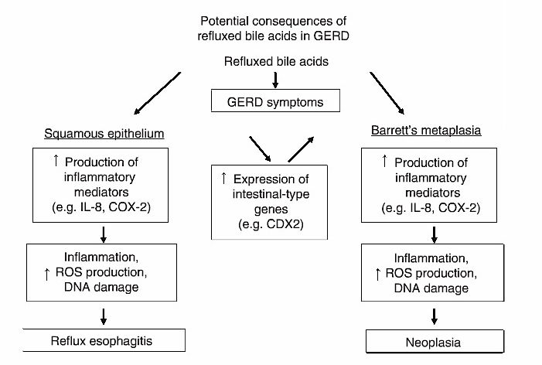
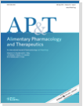
McQuaid KR et al 2011

Slide 27
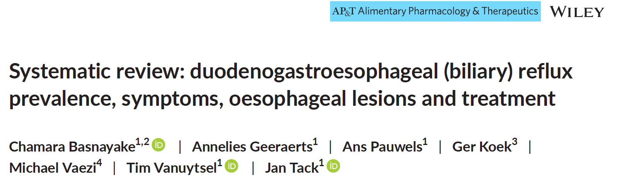

Which therapy?
PPIs 9 studies
Prokinetic agents 2 studies
Histamine receptor antagonist 1 study
Baclofen 1 study
10 studies Bilitec 2000 as the device to measure bile reflux,
3 studies used a sodium ion electrode.
Only 1 study utilised a randomised controlled trial design
2021

Slide 28
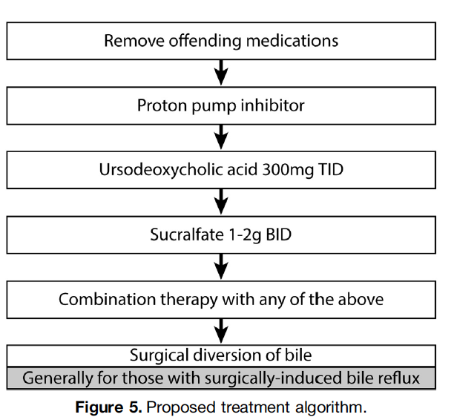
Which therapy?

Slide 29
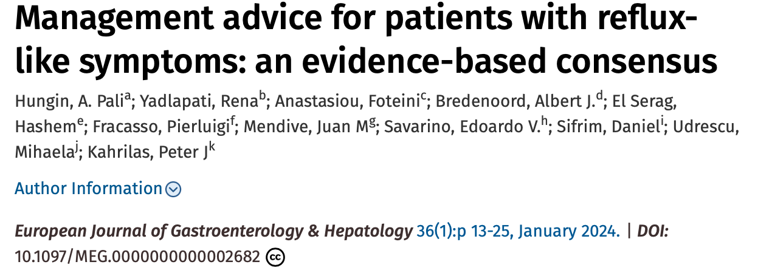
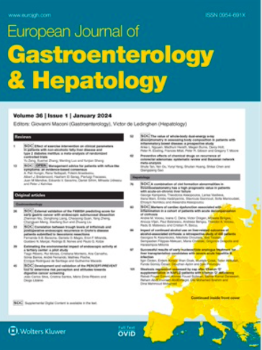
Statement 18: Alginate-antacid combinations are an effective treatment for reflux-like symptoms. Agreement: 100% (6, 90.9%; 5, 9.1%;
grade of evidence: A; strength of recommendation: high).
Statement 21: Products containing hyaluronic acid and chondroitin sulphate are an effective treatment option for reflux-like symptoms. Agreement: 81.8% (6, 82%; 5, 18%; grade of evidence: B; strength of recommendation: low).

Slide 30
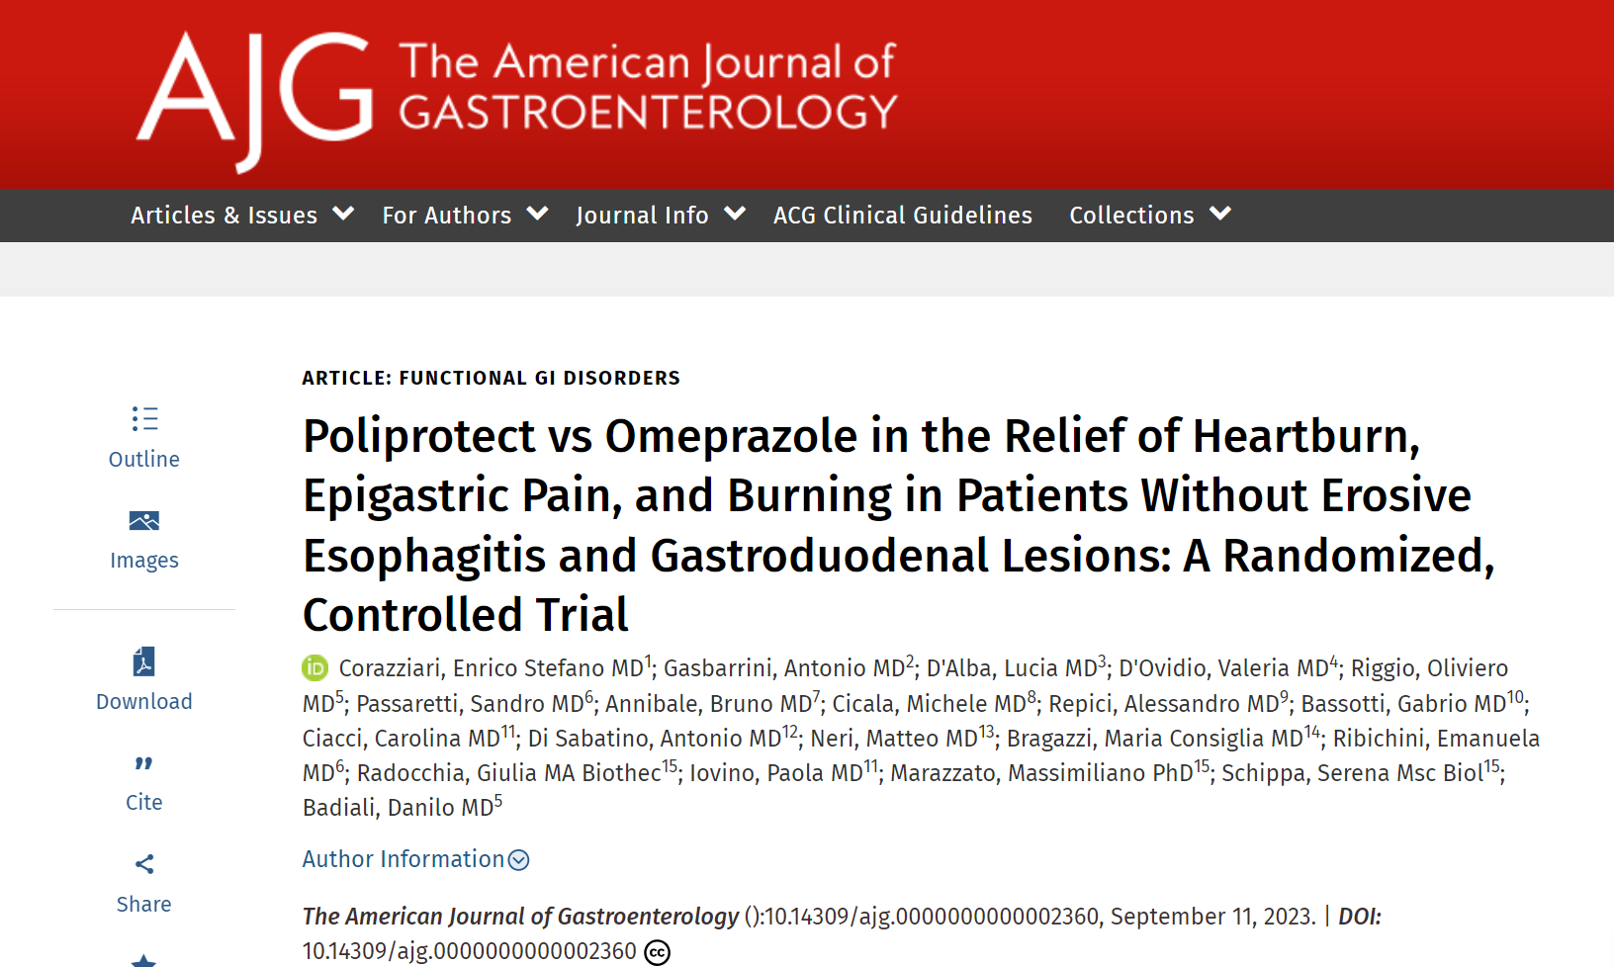
PROTEZIONE DELLA MUCOSA:
NUOVE EVIDENZE
prodotto 100 % naturale costituto da Poliprotect e da una frazione flavonoidica da Glycyrrhiza glabra and Matricaria recutita)
Poliprotect è costituito da:
Frazione polisaccaridica aderente all'epitelio da Aloe vera, Malva sylvestris e Althaea officinalis
per rafforzare la barriera epiteliale
Componenti antiacidi dai minerali naturali limestone e nahcolite incorporati nella frazione polisaccaridica
per tamponare l'acido sull’epitelio al quale aderisce

Slide 31
Is biliary reflux increased after OAGB?

Slide 32

there is still a long journey ahead of us.

Slide 33
Grazie

